Slide 1
ShipPing Optimization System
GROUP MEMBERs:
Ali Hassaan Mughal & Muhammad ROSHAN MUGHEES
173627 & 193590

Slide 2

WHAT IS SHIPPINg OS?
A Logistics Program.
Used for
Warehousing,
Inventory keeping and
Product distribution networks.

Slide 3
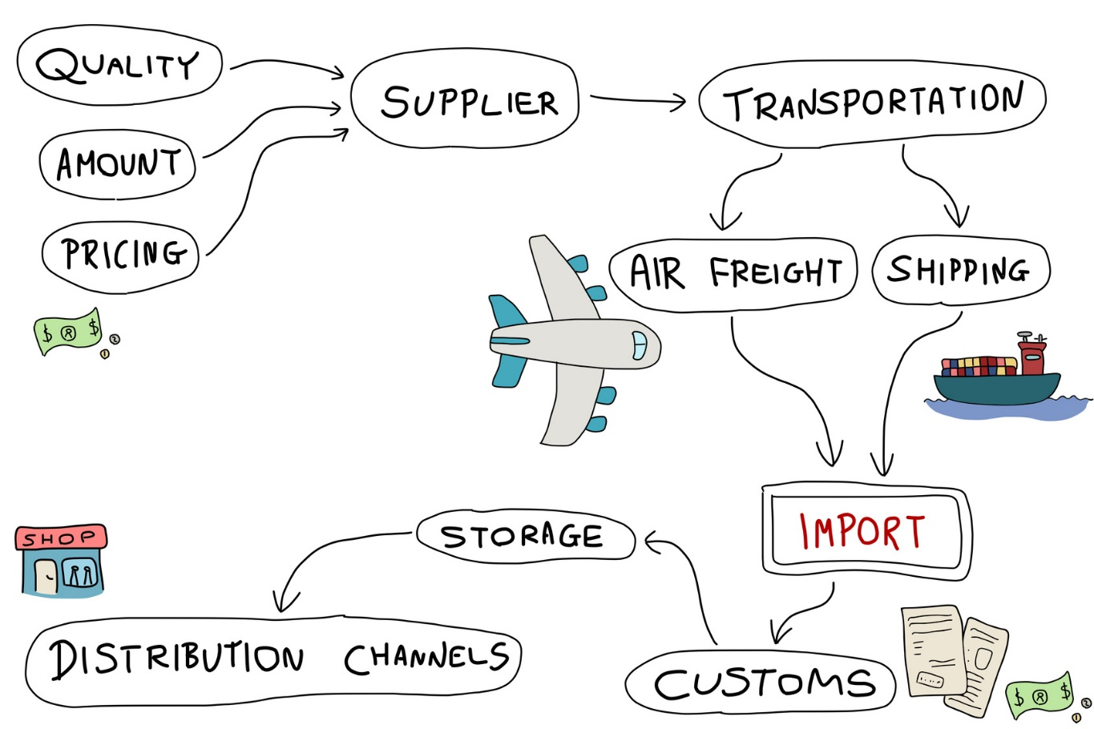
Major issues
Many problems relating to online purchases including
Inventory management
Supply chain management
Logistics
Data warehousing
Production
Inventory keeping
Distribution channels
Associated costs

Slide 4

Major issues - Continued
Location of retail stores and the warehouses at various locations in the Country.
Delivery of the products from the closest store as per the address provided by the customer – main challenge.
Huge costs occurrences. Why?
the closest retail outlets and
It’s a tough job to calculate the distance properly.

Slide 5
Need of Shipping OS:
Need of SOS for the staff responsible for product delivery – Why?
To have the channel for delivery rooted out properly in order to send the product in the minimum time possible
To save travelling and time costs.
Need of SOS for the staff responsible for inventory management – Why?
To know which products are less in number
To order more products from production team or
To remove a product from shelfs if it’s demand is low

Slide 6
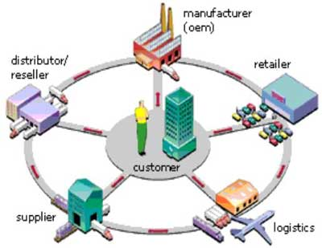
Need of Shipping OS
Need of SOS for the staff responsible for inventory management – Why?
To know the types, sizes, variety, quantity etc. of the products to supply them to the customers ordering online
To layout which products leave the warehouse as per their bar code on the spot
To help upkeep an updated inventory

Slide 7
Our PROPOSED SOLUTION – Shipping OS
Solution - To deal with challenges and issues is our project “SOS“
HOW?
It can be used to calculate
The exact location of the closest ware houses of the proposed brand and
The client’s location and
Will layout the shortest route possible from the nearest warehouse (How?)
By making use of google maps.

Slide 8

Cont.
Shipping OS will also
Calculate the total products of that certain order in the nearest warehouse
And their sizes and
Deduct it automatically from the inventory (How?)
By using the product id or bar code.

Slide 9

Challenges
Choice of Data Structures To be Used for Invertory Listing and Efficiently linking the WareHouses, Orders and Items with each Other Using OOP Concepts.
Optimization of the old Approach towards the Solution to make it more time efficient.
First Time Using the External APIs and Browser which isn’t efficient, having a limited time license.
Scrapping the Data in JSON Format using Google Maps API and Extracting useful information like distance and time from it.

Slide 10
Thankyou ☺

